Slide 1

Telecom Customer Churn Analysis
Presented By
Vaishnavi Chougule

Slide 2
About :
Vaishnavi Mahadev Chougule
B. Sc. In Computer Science (Shivaji University, Kolhapur)
Profiles:
LinkedIn: www.linkedin.com/in/vaishnavi-chougule-3b7206323
Github: https://github.com/vaishnavi-chougule

Slide 3
INDEX
Project Objective
2. Purpose of Dataset
3. Data Preparation
4. Key Visuals
5. Dashboard
6. Key Insights from Analysis
7. Experience & Challenges
8.Conclusion

Slide 4
Project Objective :
To transform raw telecom customer data into meaningful insights that reveal churn drivers, high-risk segments, and opportunities to reduce customer loss.
To identify churn trends across demographics, services, contracts, and payments, enabling data-driven strategies for improving loyalty and long-term profitability.
To build an analytical dashboard that helps stakeholders understand who is churning, why they churn, and how to minimize churn effectively.

Slide 5
Purposes of the Dataset :
To analyze customer churn patterns
To understand customer demographics & behavior
To evaluate service subscription trends
To study billing & payment behavior
To identify high-risk customer segments
To support churn prediction & retention strategies

Slide 6
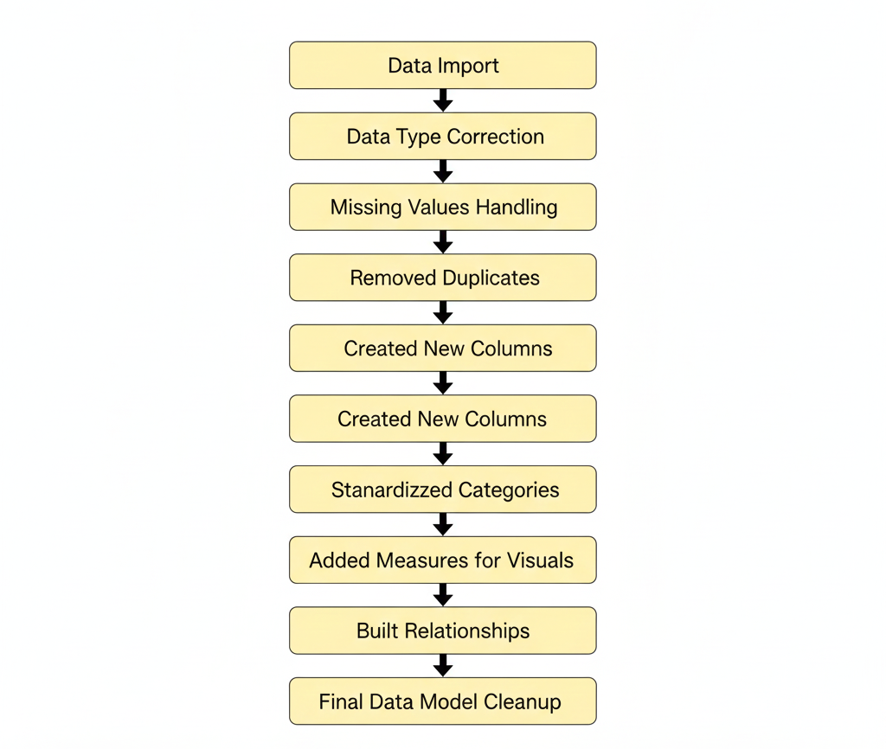
Data Preparation :

Slide 7
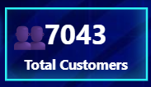
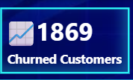
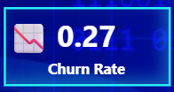
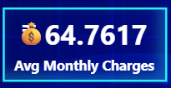
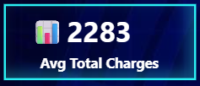
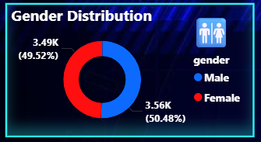
Key Visuals:
Cards
Chart Name : Donut Chart
Insights :
Predictive churn models will not be biased towards a single gender.
It strengthnens demographic fairness in churn analysis

Slide 8
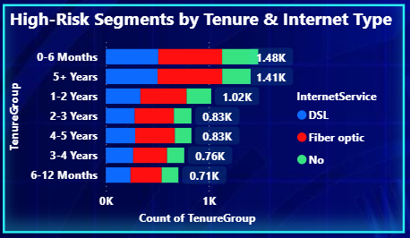
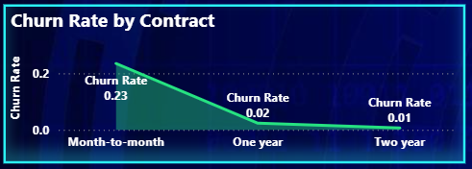
Chart Name : Stacked Bar Chart
Insights :
Fiber optic customers dominate in almost every tenure group
DSL users show moderate risk
Customers with NO Internet service (green bars) are the least risky
Chart Name : Area Chart
Insights :
Month-to-Month Customers Have the Highest Churn
Two-Year Contract Customers Show Very Low Churn
Churn Rate Decreases Dramatically with Longer Contracts

Slide 9
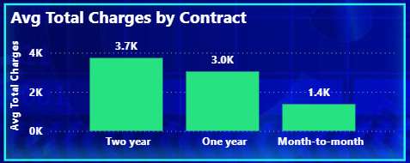
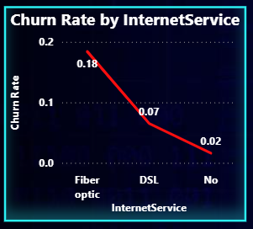
Chart Name : Stacked Column Chart
Insights :
Two-Year Contract Customers Have the Highest Total Charges
Month-to-Month Customers Generate the Lowest Total Charges
Clear Positive Relationship: Longer Contracts → Higher Total Charges
Chart Name : Line Chart
Insights :
Fiber Optic Customers Have the Highest Churn Rate
Customers Without Internet Service Show the Lowest Churn
More Advanced Internet Service = Higher Churn

Slide 10
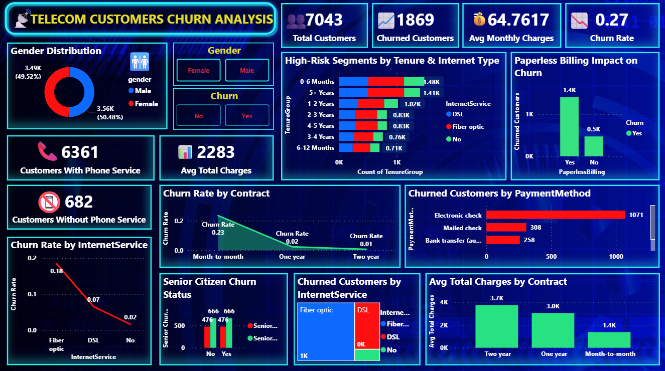
Dashboard :
Power BI - https://app.powerbi.com/groups/me/reports/37680801-9757-4999-9180-9bba77c27a35?pbi_source=desktop&noSignUpCheck=1

Slide 11
Key Insights from Analysis :
1. Churn Is Concentrated in Specific Segments
Majority of churn comes from Month-to-Month, Fiber Optic, and Electronic Check users.
2. Tenure Strongly Predicts Loyalty
Customers in their first 6 months are the most unstable.
Churn steadily drops as tenure increases.
3. Billing Preferences Influence Customer Retention
Paperless billing customers churn nearly 3× more than non-paperless users.
➡ Indicates dissatisfaction or weak communication.

Slide 12
4. Internet Reliability Appears to Drive Churn
Fiber optic users churn much higher than DSL.
➡ Possible service quality, speed, or pricing concerns.
5. Payment Flexibility Reduces Churn
Automatic Bank Transfer & Credit Card users show very low churn, suggesting convenience encourages retention.
6. Customer Value Grows with Contract Length
Two-year contract customers bring highest total charges, indicating long-term customers are more profitable.
7. Customers Without Phone Service Churn Less
Users with No Phone Service show lower churn, possibly due to simplified billing.
8. No Major Gender Bias in Churn
Male and Female customers churn almost equally, meaning churn is driven by service/contract factors, not demographics.

Slide 13
Experience & Challenges
✔ Experience Gained
Learned how to clean, transform, and model data using Power Query.
Built interactive dashboards using cards, slicers, and advanced visuals.
Improved skills in DAX calculations (churn rate, averages).
Learned to create relationships, use measures, and optimize visuals for clarity.
⚠ Challenges Faced
Handling inconsistent data formats and cleaning missing/blank values.
Difficulty in identifying correct DAX formulas for KPIs.
Making the dashboard visually clear without cluttering too many charts.
Ensuring relationships were correct in the data model view.
Managing performance after adding multiple visuals.

Slide 14
Conclusion :
This project successfully analyzed Telecom Customer Churn using a fully interactive Power BI dashboard.
The analysis highlighted key churn drivers such as contract type, internet service, paperless billing, and tenure.
High-risk customer segments were clearly identified, enabling data-driven decision-making for retention strategies.
KPIs like Total Customers, Churned Customers, Churn Rate, and Average Charges provided a quick business overview.
Visual insights revealed that short-tenure customers and month-to-month contracts have the highest churn probability.
The dashboard empowers telecom companies to reduce churn, improve customer experience, and optimize revenue by focusing on the most vulnerable segments.
Overall, the project demonstrates how Power BI transforms raw data into meaningful, actionable business insights.

Slide 15

THANK YOU

